Slide 1


(Operations) Nightmare before Christmas IBM Cloud Pak for Watson AIOps
Niklaus Hirt
Partner Technical Specialist
Cloud/ DevOps Architect
IBM Automation

Slide 2


IBM CloudPak for Watson AIOps Demo
CloudPak for Watson AIOps
Demo Apps
AI Manager
Log Stream
Robotshop
Events
QOTD
Correlation
2

Slide 3
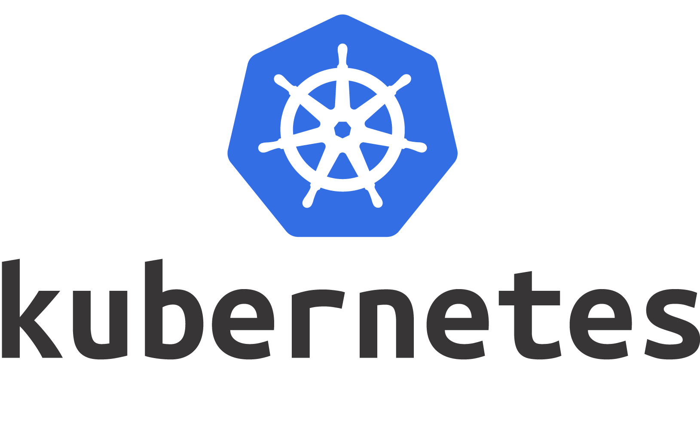




IBM CloudPak for Watson AIOps Demo
CloudPak for Watson AIOps
Demo Apps
AI Manager
Log Stream
Events
Event Grouping
Robotshop
Events
QOTD
Correlation
3

Slide 4



IBM CloudPak for Watson AIOps Demo
CloudPak for Watson AIOps
Demo Apps
Logs
AI Manager
Log Anomaly
Detection
Log Stream
Events
Event Grouping
Robotshop
Events
QOTD
Correlation
4

Slide 5
IBM CloudPak for Watson AIOps Demo
CloudPak for Watson AIOps
Demo Apps
Logs
AI Manager
Log Anomaly
Detection
Log Stream
Events
Event Grouping
Robotshop
Metrics
Metric Anomaly Prediction
Events
QOTD
Correlation
5

Slide 6
IBM CloudPak for Watson AIOps Demo
CloudPak for Watson AIOps
Demo Apps
Logs
AI Manager
Log Anomaly
Detection
Log Stream
Events
Event Grouping
Robotshop
STORY
E
Metrics
Metric Anomaly Prediction
E
Events
QOTD
Correlation
6

Slide 7
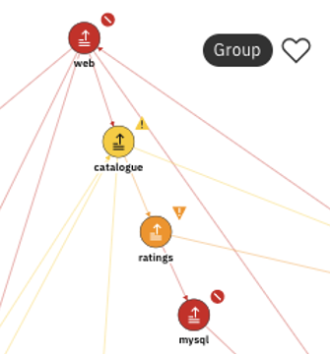
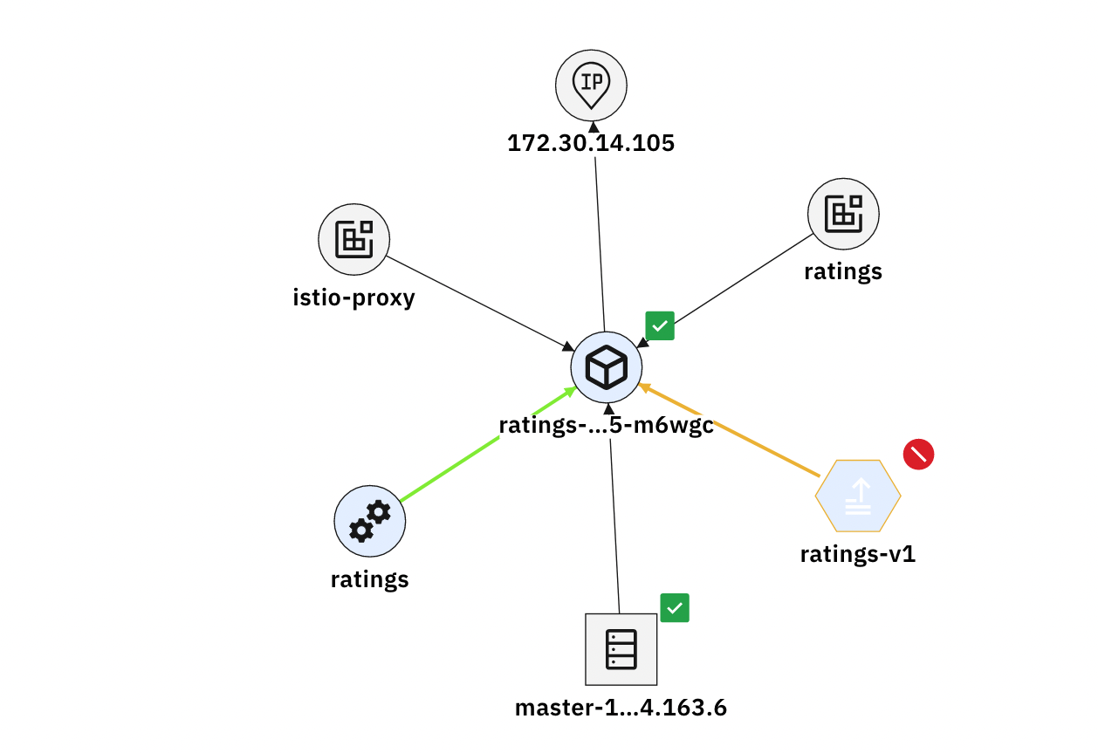

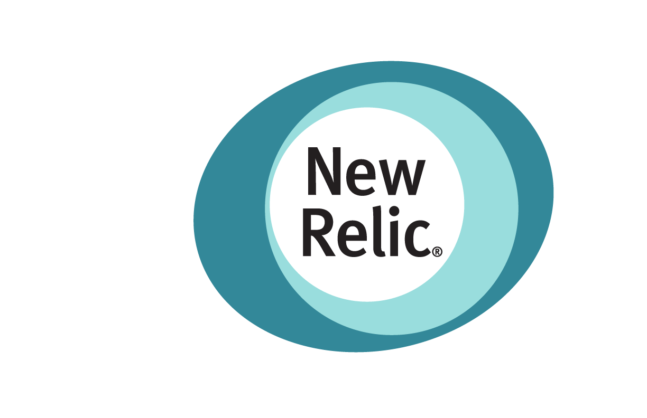

IBM CloudPak for Watson AIOps Demo
CloudPak for Watson AIOps
Demo Apps
Logs
AI Manager
Log Anomaly
Detection
Log Stream
Events
Event Grouping
Robotshop
STORY
E
Metrics
Metric Anomaly Prediction
E
Events
QOTD
Topology
Topology
Correlation
Enrichment
7

Slide 8
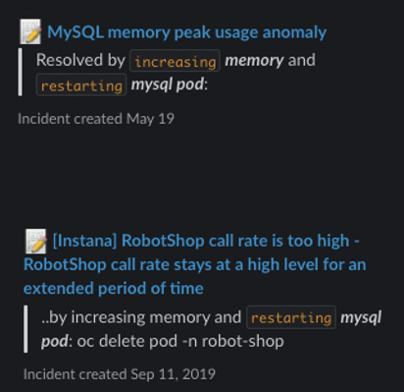

IBM CloudPak for Watson AIOps Demo
CloudPak for Watson AIOps
Demo Apps
Logs
AI Manager
Log Anomaly
Detection
Log Stream
Events
Event Grouping
Robotshop
STORY
E
Metrics
Metric Anomaly Prediction
E
Events
QOTD
Topology
Topology
Correlation
Enrichment
Incidents
Similar Incidents
Change Risk
Enrichment
8

Slide 9
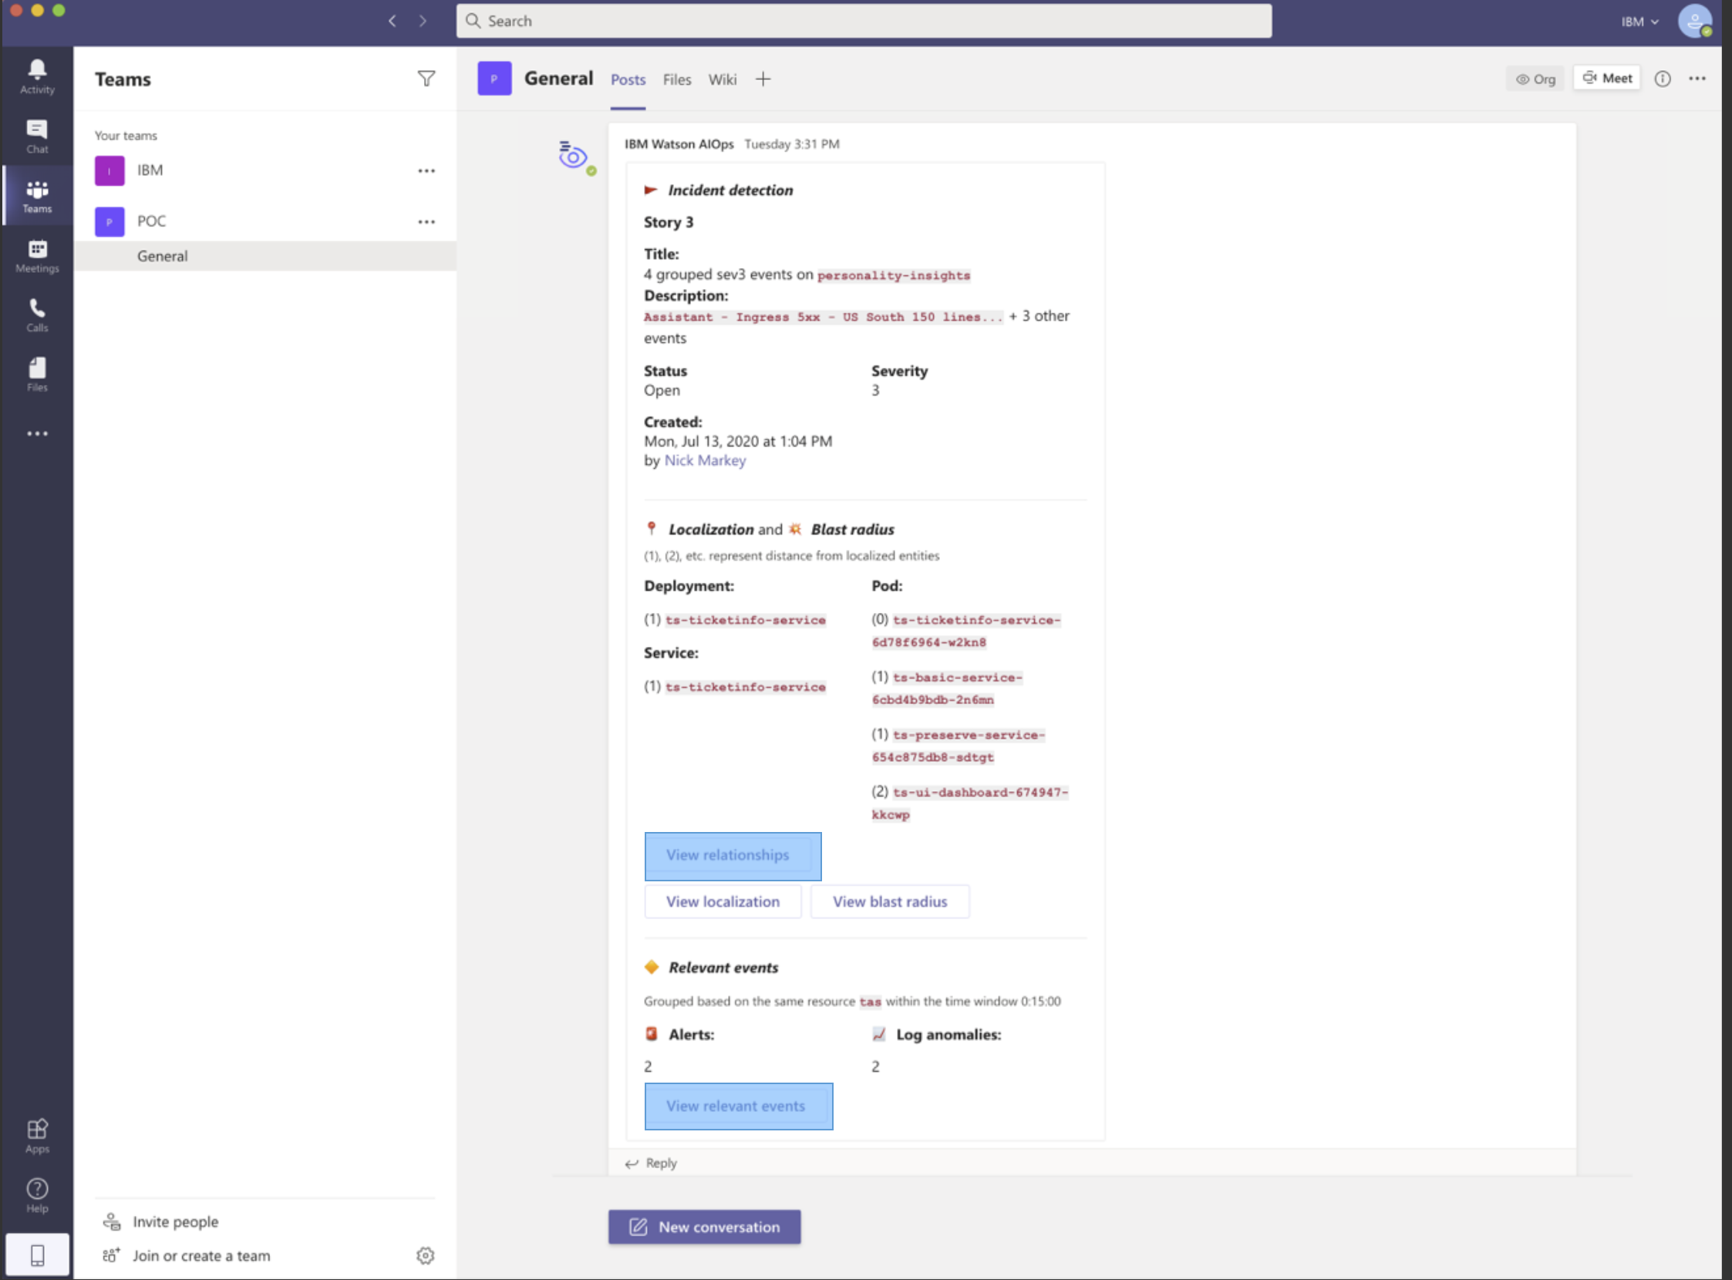
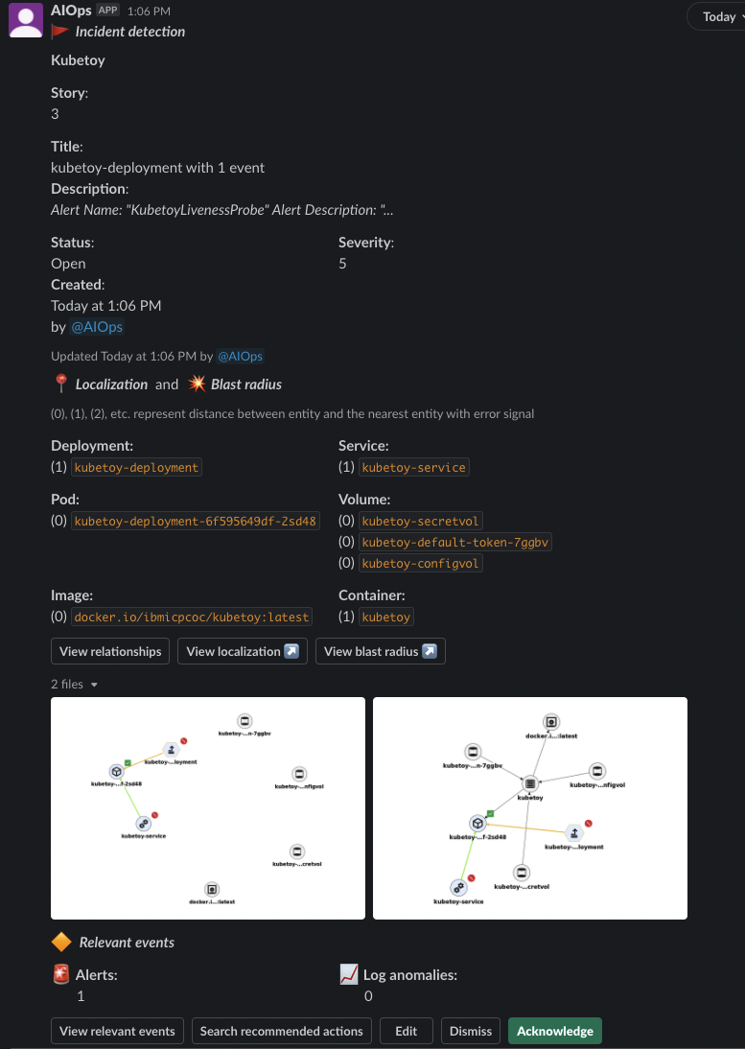
IBM CloudPak for Watson AIOps Demo
CloudPak for Watson AIOps
Demo Apps
Logs
AI Manager
Log Anomaly
Detection
ChatOps
Log Stream
Events
Event Grouping
Robotshop
STORY
E
Metrics
Metric Anomaly Prediction
E
Events
QOTD
Topology
Topology
Correlation
Enrichment
Incidents
Similar Incidents
Change Risk
Enrichment
9

Slide 10
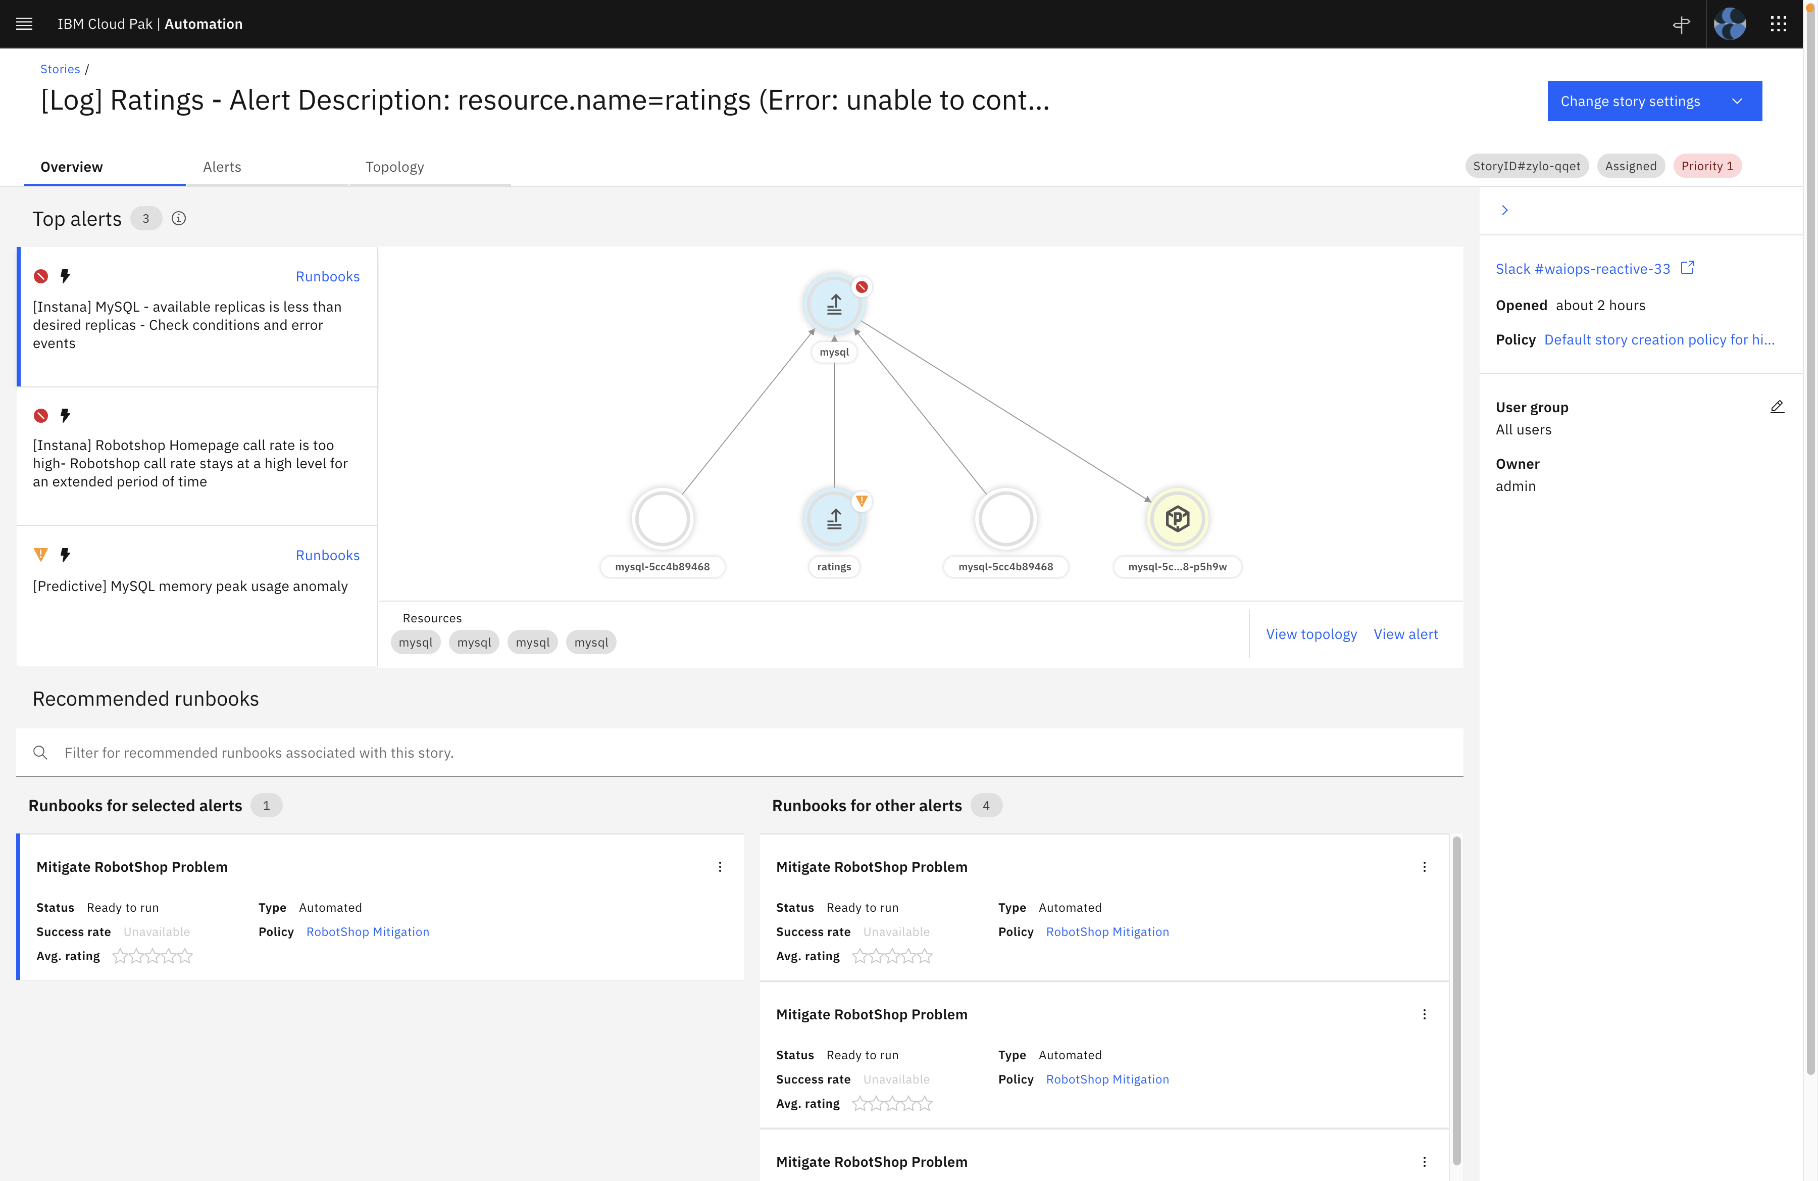
IBM CloudPak for Watson AIOps Demo
CloudPak for Watson AIOps
Demo Apps
Logs
AI Manager
Log Anomaly
Detection
ChatOps
Log Stream
Events
Event Grouping
Robotshop
STORY
E
Metrics
Metric Anomaly Prediction
E
Events
QOTD
Topology
Topology
Correlation
Enrichment
AI Manager Resolution Hub
Incidents
Similar Incidents
Change Risk
Enrichment
10

Slide 11
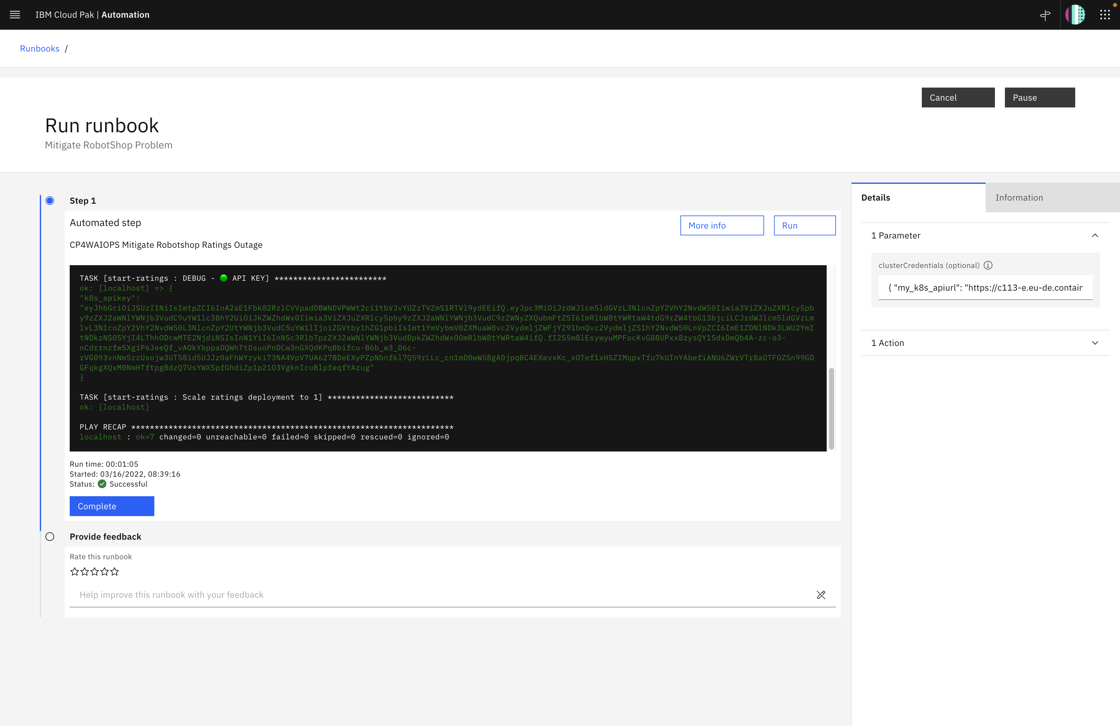


IBM CloudPak for Watson AIOps Demo
CloudPak for Watson AIOps
Demo Apps
Logs
AI Manager
Log Anomaly
Detection
ChatOps
Log Stream
Events
Event Grouping
Robotshop
STORY
E
Metrics
Metric Anomaly Prediction
E
Events
QOTD
Topology
Topology
Correlation
Enrichment
AI Manager Resolution Hub
Incidents
Similar Incidents
Change Risk
Runbooks
Enrichment
11

Slide 12
Let’s go

Slide 13
Thank you
Niklaus Hirt
Partner Technical Specialist
Cloud / DevOps Architect
—
nikh@ch.ibm.com
+41 79 948 72 46
13

